Slide 1
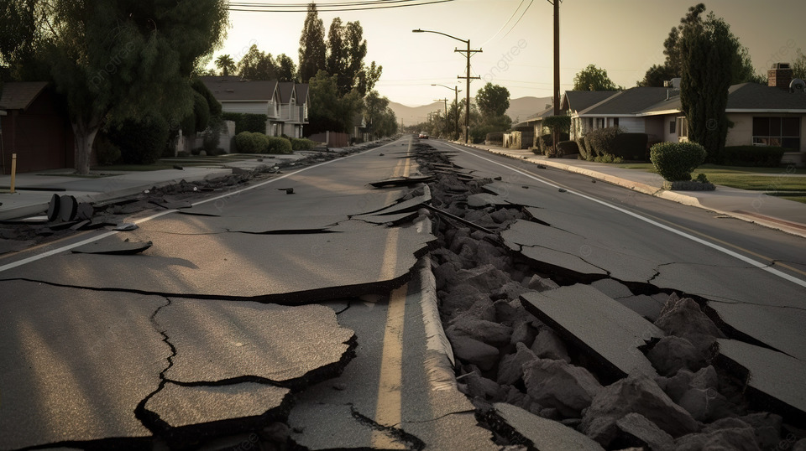




Data Analysis of Earthquake Dataset
Group – 16
1. Ashoka Chakra Varthy Sanjapu
2. Meghana Kurapati
3. Tejas Reddy Vepala

Slide 2
Introduction
Motivation: As we analyze the recent records, It shows that the earthquakes continue to provide serious problems globally, with large magnitudes and frequencies that requires the advanced prediction. When we search for the number of recent earthquakes in google it gives 161 earthquakes in past 24 hours. The aim of our project is to predict these disasters and could save the lives and resources by utilizing large amounts of seismic data.
Objectives: For Big data-related project, data exploration, visualization, model building, model evaluation, and deployment using AWS are the key objectives. In this project, we have covered all the steps which are covered in our coursework. We try to utilize various big data technologies such as AWS, Hive, Hadoop, and Jupyter Notebook, alongside machine learning models.​
Significance: This big data project is significantly advanced earthquake predictions by integrating big data technologies and ML models , We enhanced our ability to forecast the seismic events more accurately And this will lead to better preparedness to authority and potentially reduces the risks, Minimize the economic losses.
Source: The Largest Earthquakes in the World by earthquake track referred from
https://earthquaketrack.com/biggest

Slide 3
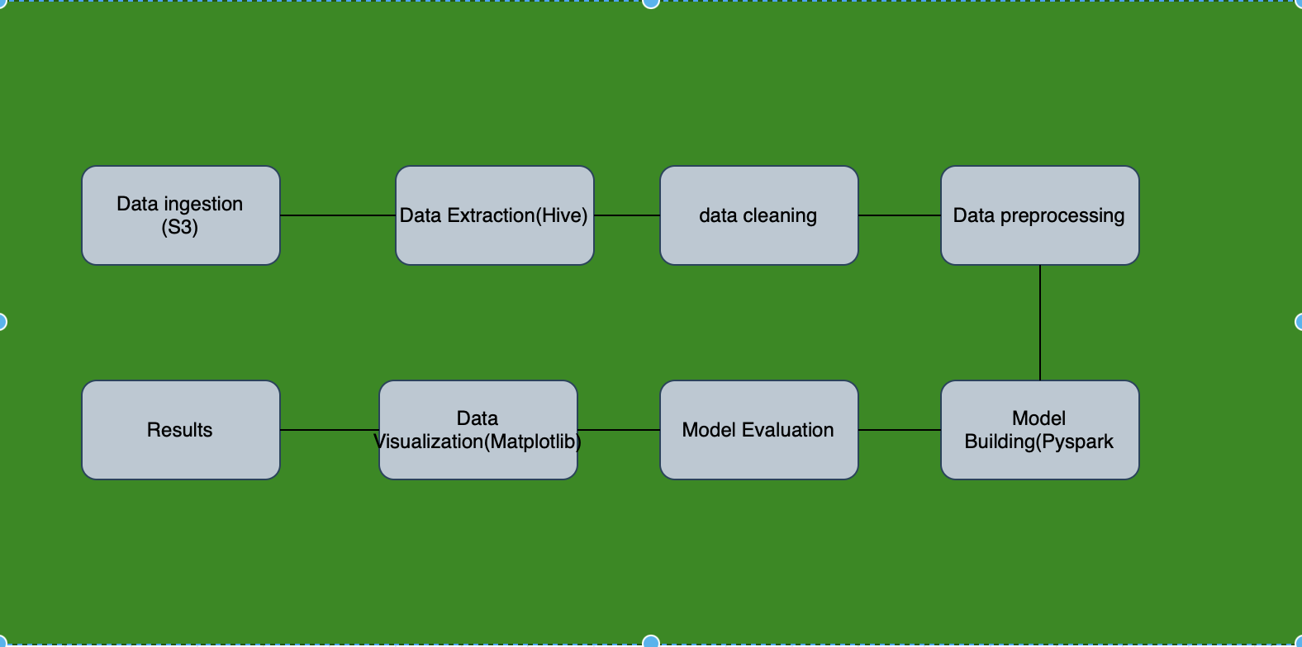
Workflow Diagram

Slide 4
Architecture
Data Source: Data is downloaded from the canvas which is given by the professor. There are two types of datasets, i.e Current and main.
Data Storage: Storing the data in S3 buckets
Data Preprocessing: Using PySpark and Hive
Data Analysis: Created tables in Hive and perform queries in HiveQL for data Analysis.
Data Integration: Hive/Pyspark
Infrastructure Management: AWS is the cloud service is used for hosting the databases

Slide 5
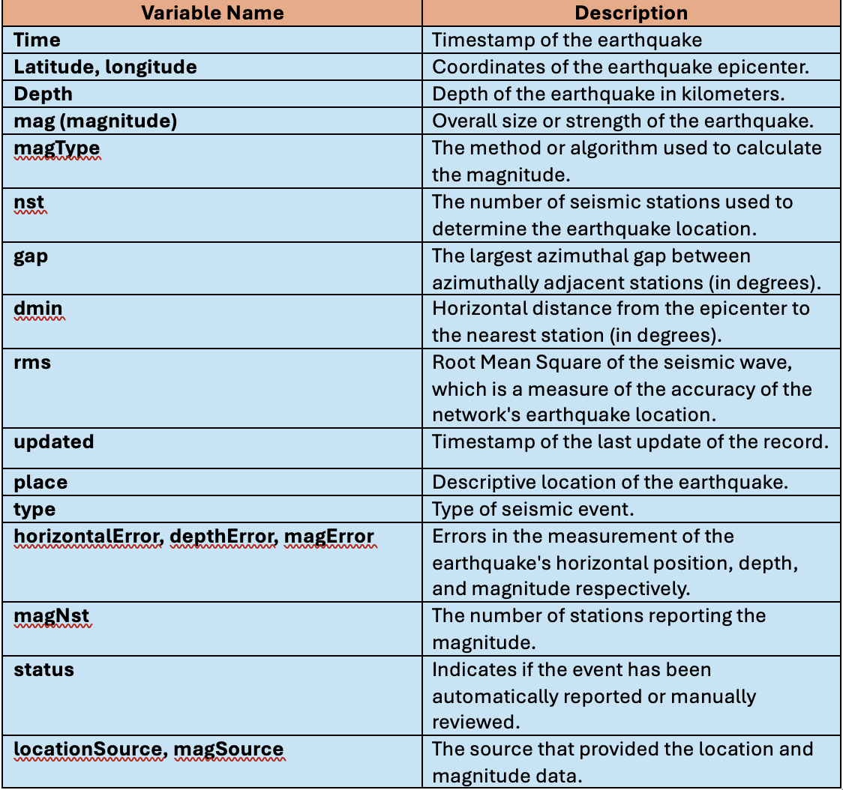

Dataset Description

Slide 6
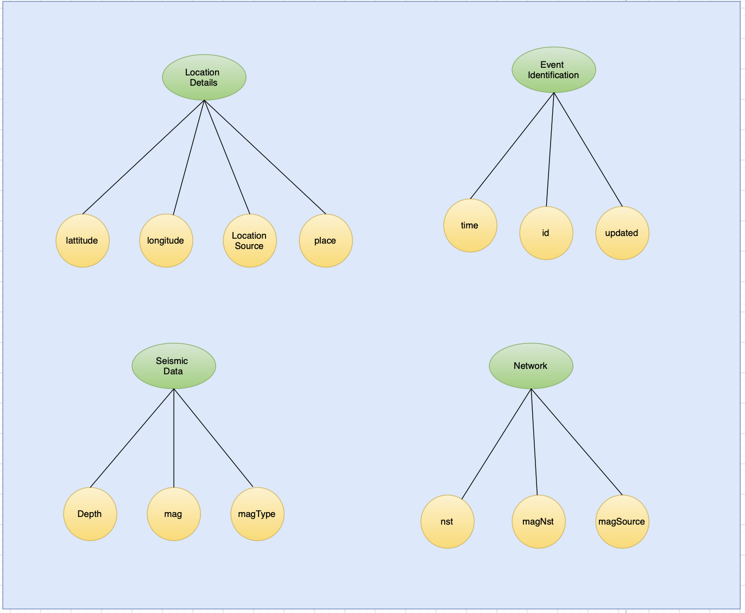
Design of Features with diagram

Slide 7
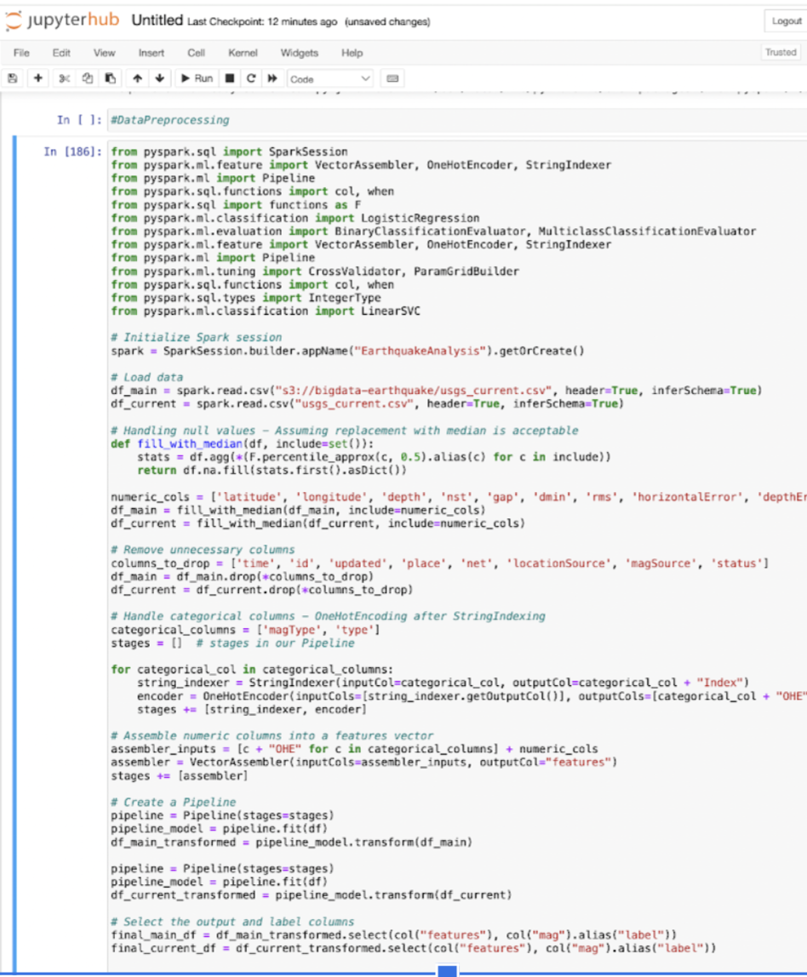
Data -Preprocessing
Basically, data preprocessing in ML involves several steps which involves data cleaning, data transforming, and organizing the raw data into a useful format to improve the accuracy of the model and efficiency of analysis.
In the right-side code snippet, we initialize the spark session, load the data from S3 buckets and preprocess the earthquake data.
Here we handle the missing values, dropping unnecessary columns, encoding categorical variables using OneHotEncoding.

Slide 8
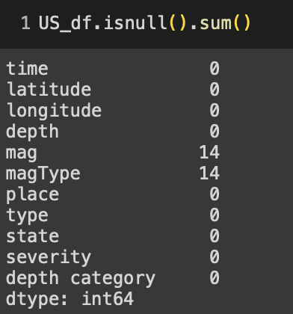
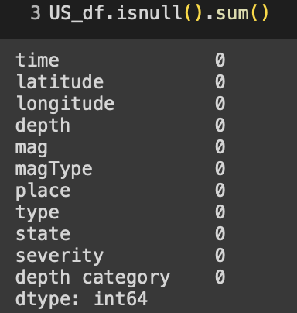

Slide 9
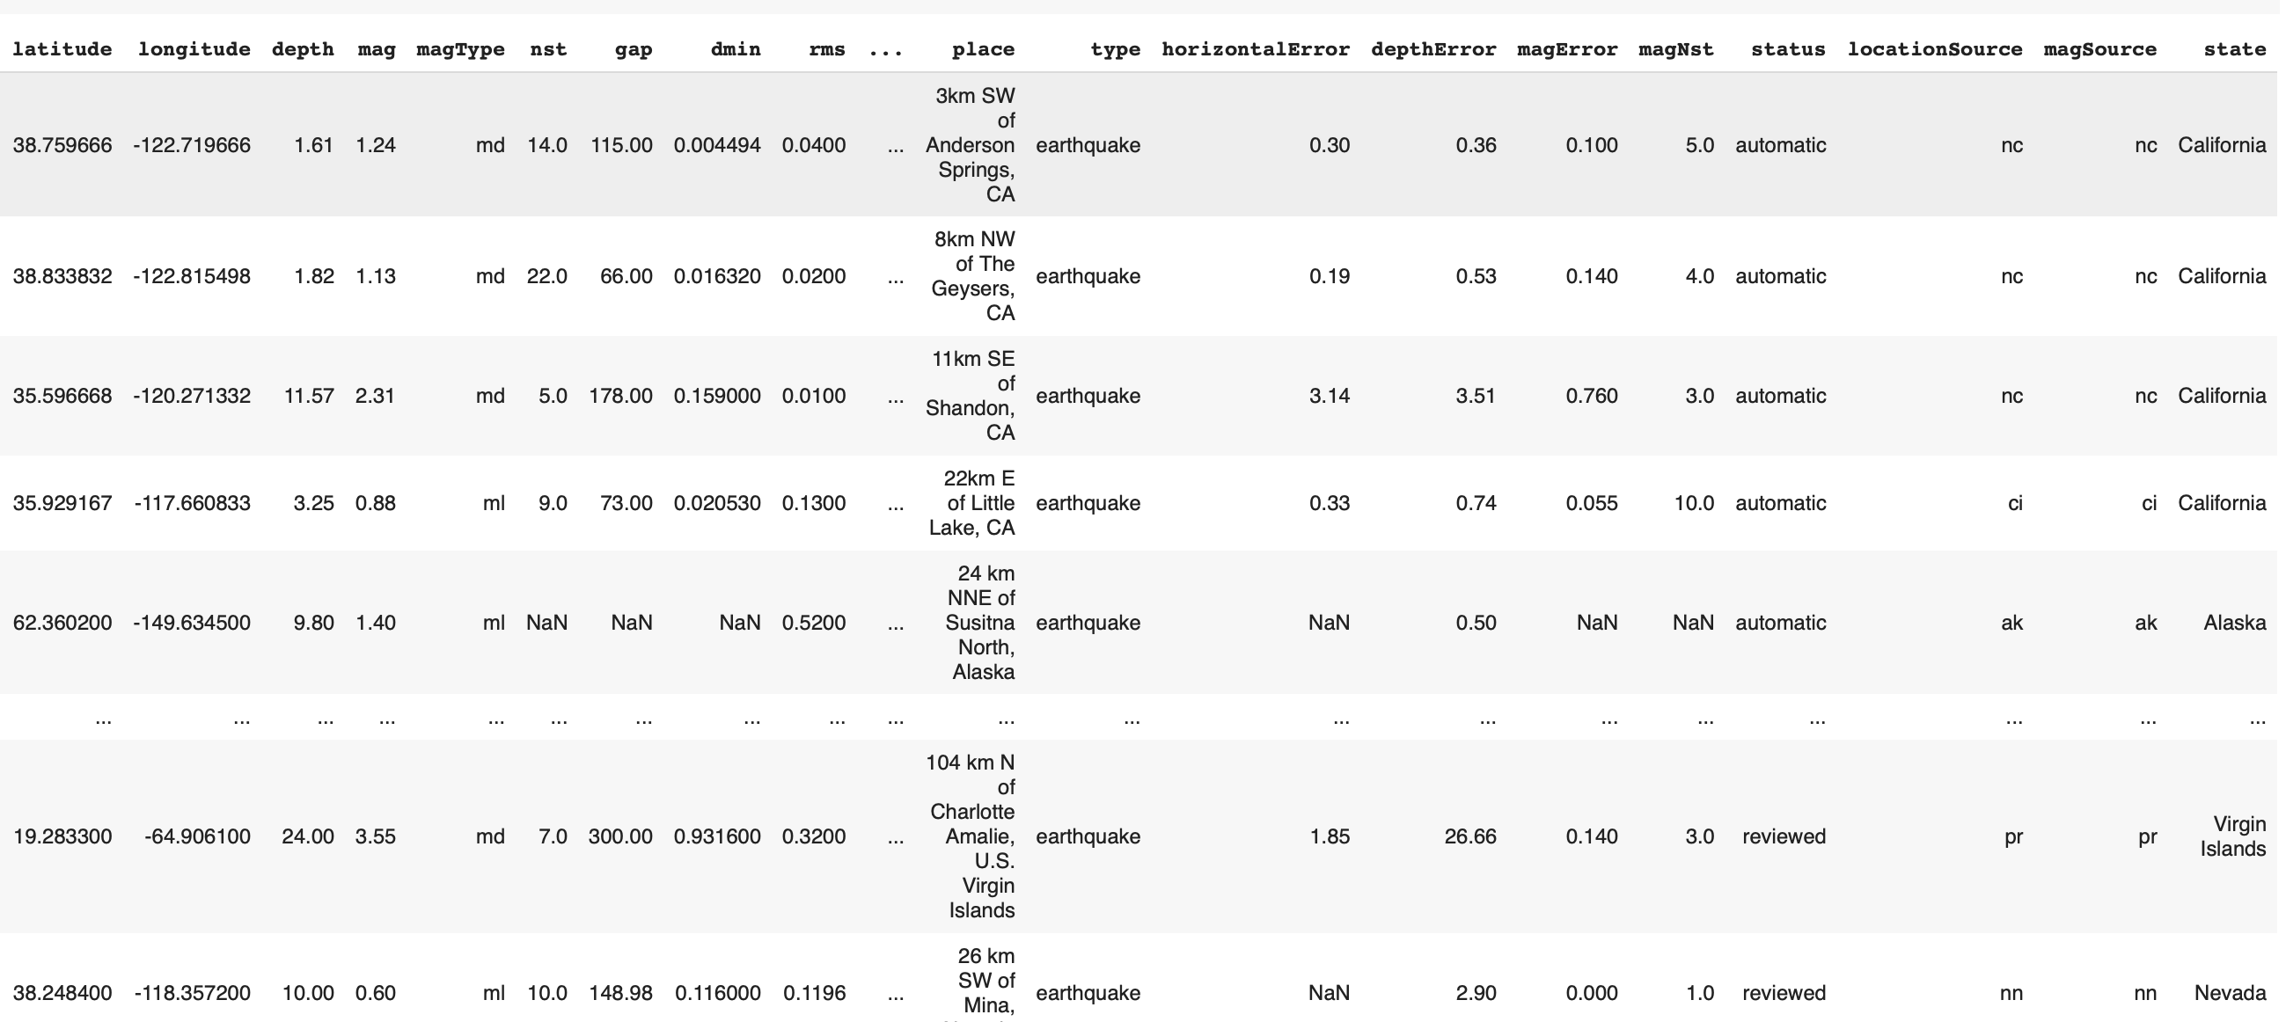
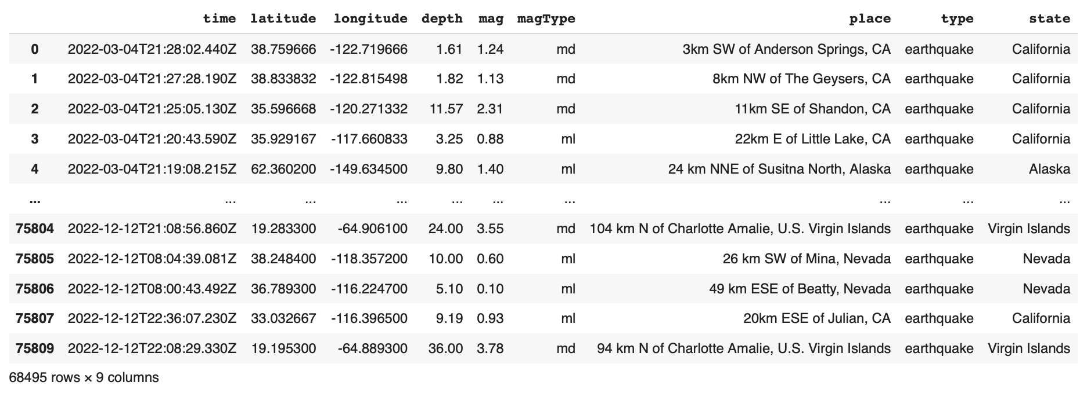
After the couple of preprocessing steps to extract new features from the existing data, we added a 'state' variable derived from the 'place' attribute and this 'state' variable is useful for feature analysis. We also eliminated unnecessary columns and removed null values from the data.

Slide 10
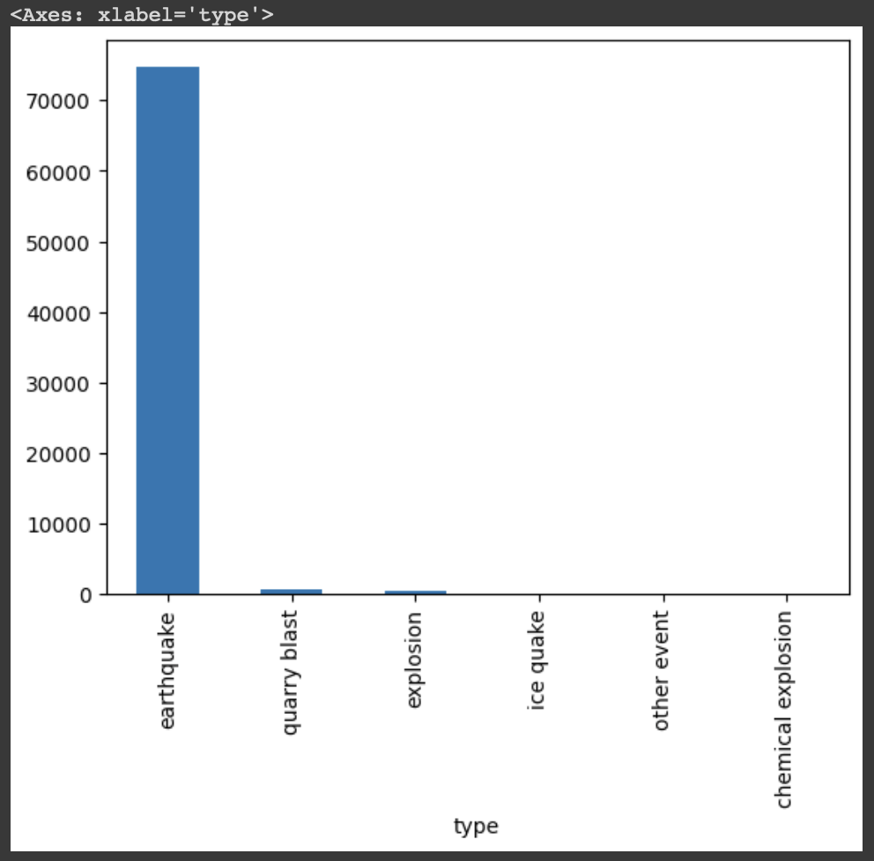
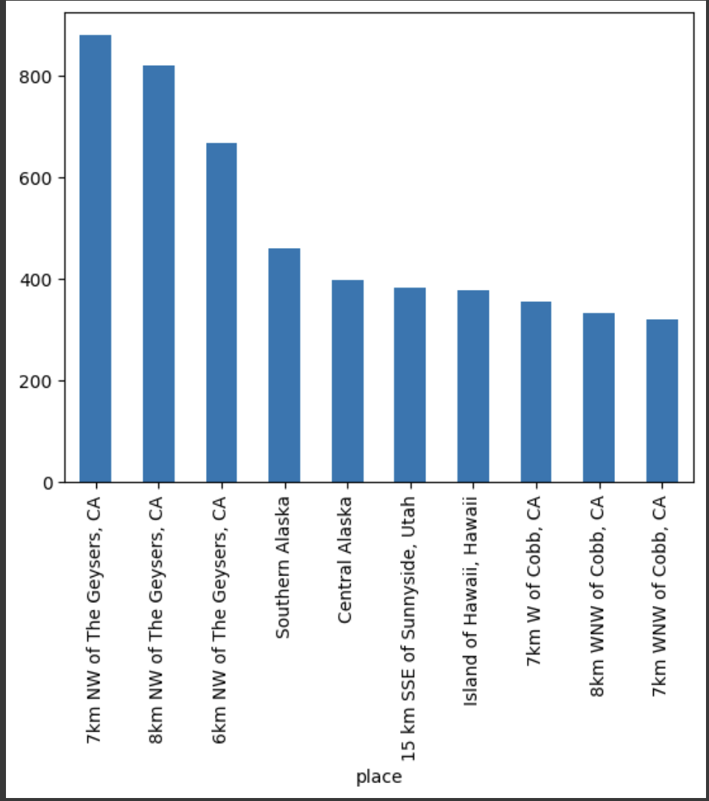
Data Visualization
Here the first bar graph displays the distribution of different types of seismic events, and we can observe that earthquakes has the highest number. And the second bar graph find the place with highest number of earthquakes.

Slide 11
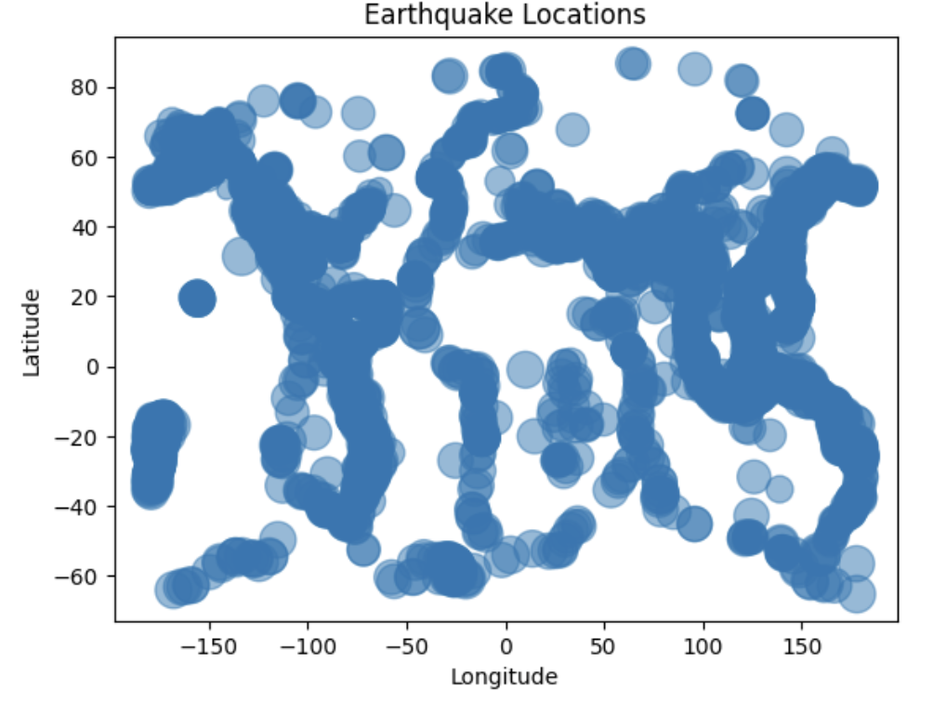
This graph displays the earthquake locations globally and depicting each earthquake latitude and longitude. Here the size of each circle representing the frequency of earthquakes

Slide 12
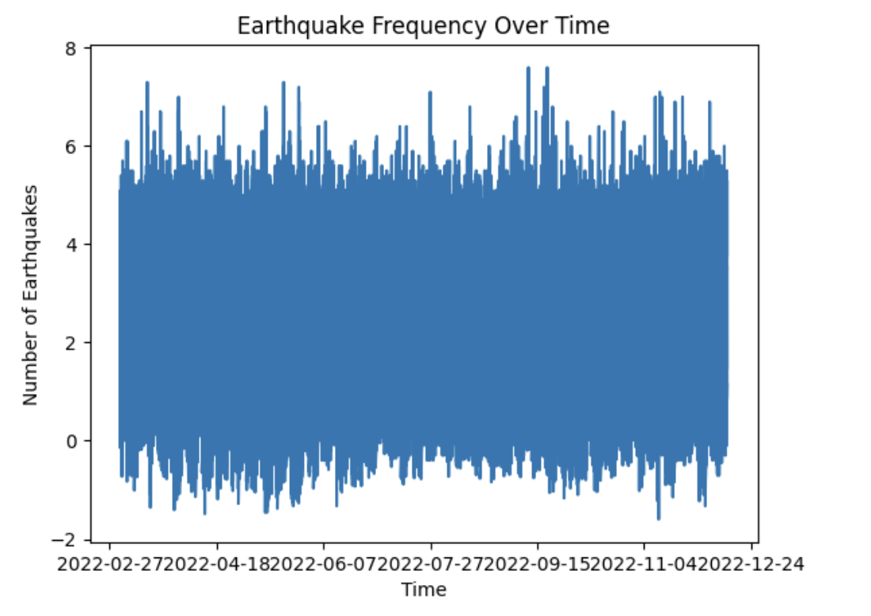
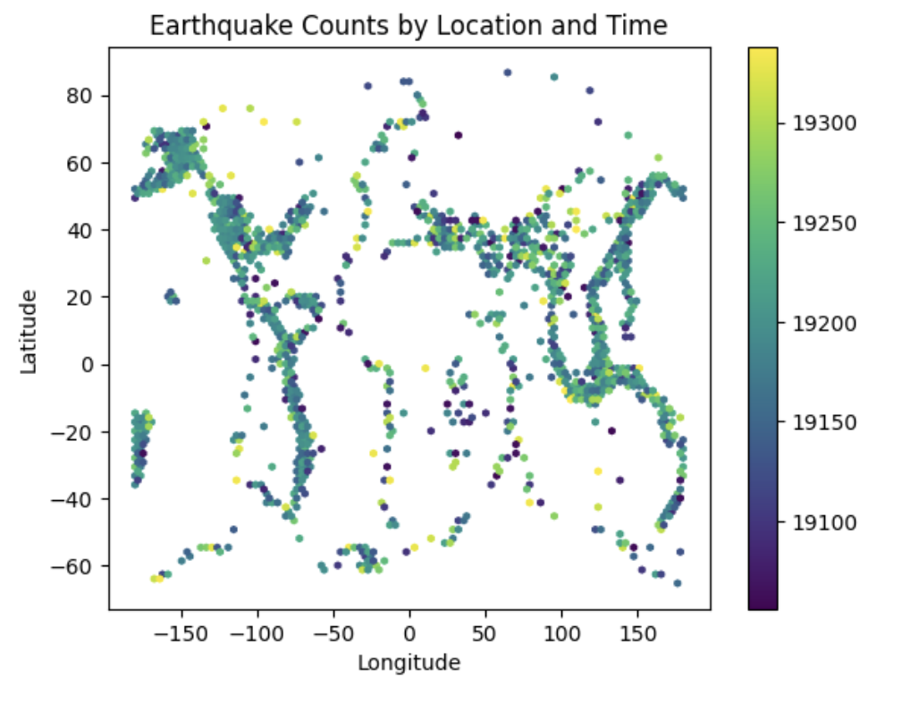
The first graph displays the frequency of earthquakes over the time and illustrating fluctuations in the daily counts throughout the year 2022.
The scatter plot maps the earthquake counts by location and time, using the colors to indicate the changes, demonstrating the higher seismic activity in certain regions.

Slide 13
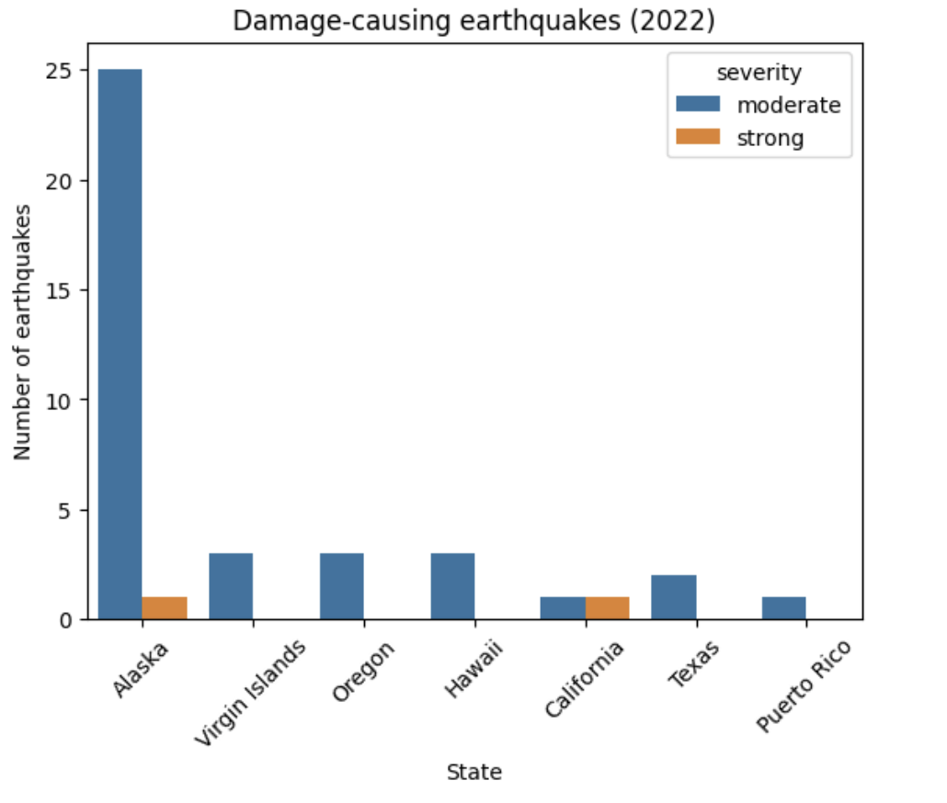
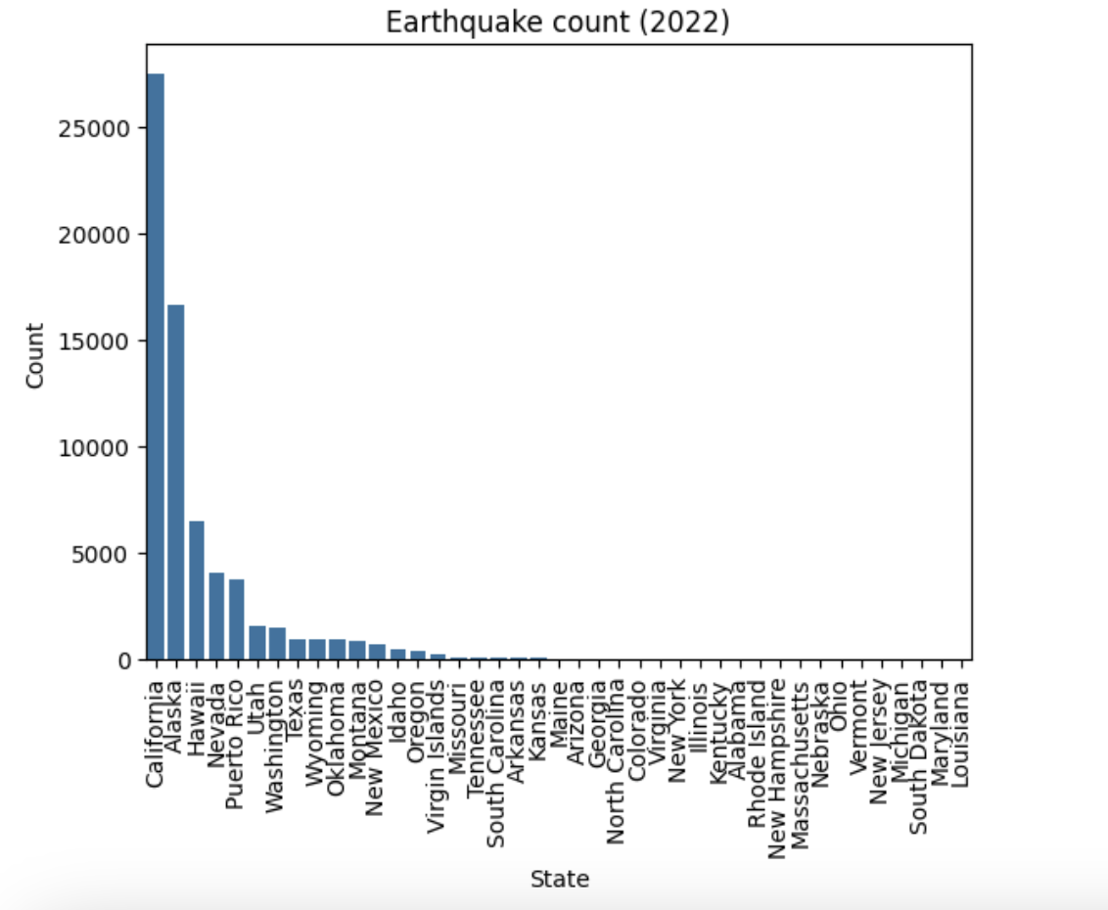
The below graphs shows the distribution of seismic events across different states with California, The second graph is categorizing the earthquakes by severity in selected locations, showing the high moderate earthquakes in Alaska and a mix in other regions.

Slide 14
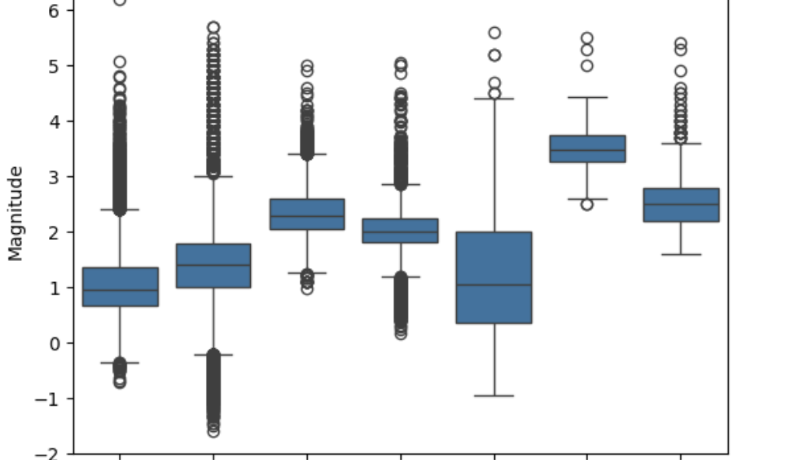
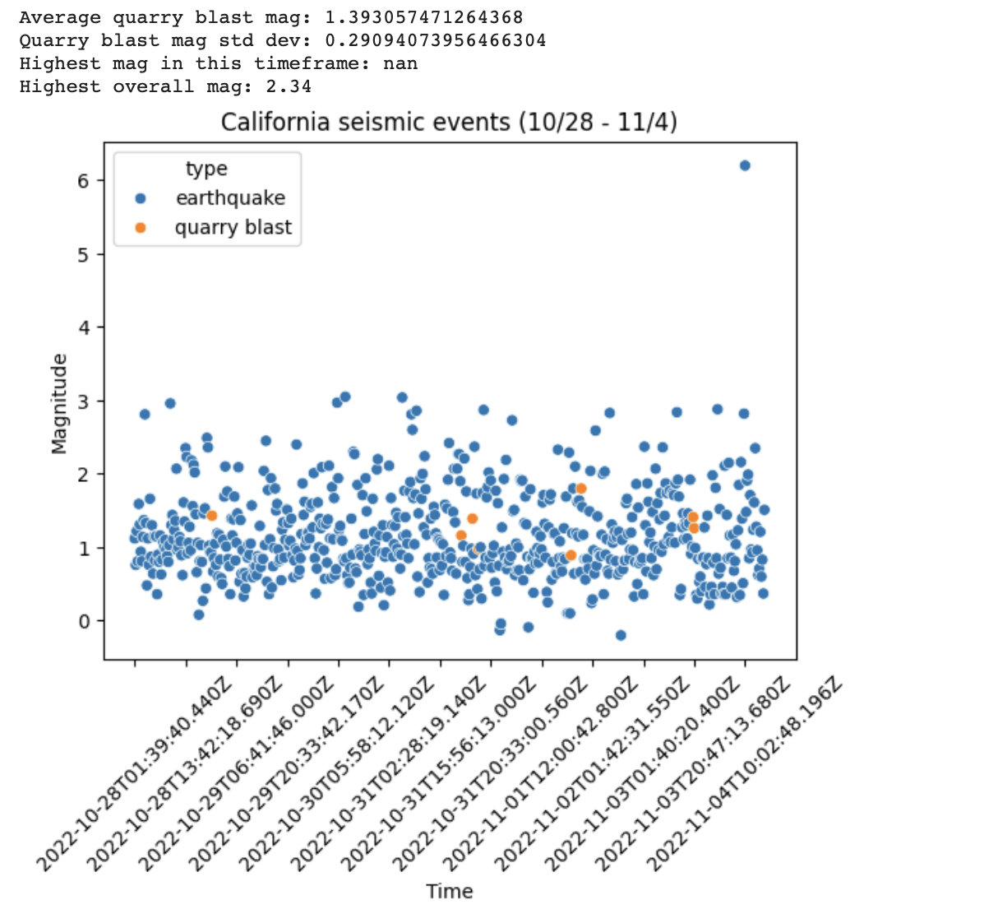
In the below, the first graph illustrates the seismic events in California over a particular time-period and plotting earthquakes and quarry blasts with their respective magnitudes over the time and highlighting an outlier (earthquake) with the highest magnitude of 2.34. The second graph compares the distribution of earthquake magnitudes of various states and territories in the year of 2022

Slide 15
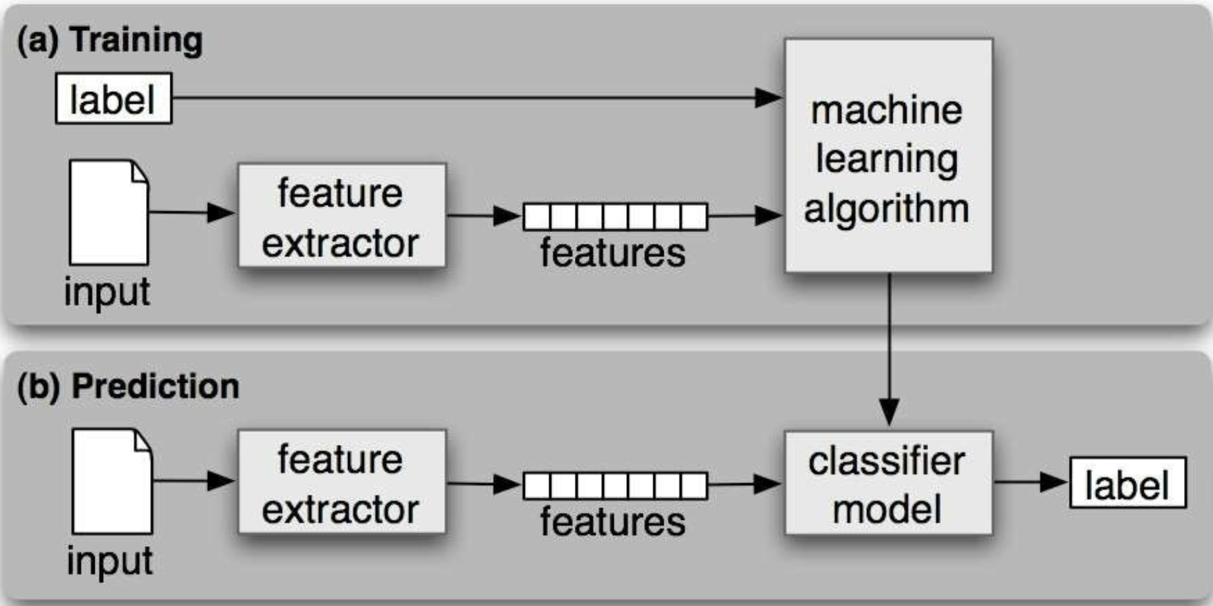
Implementation
Machine Learning Pipeline:
Below is the process for Machine Learning Models
Features are Extracted from the input data and apply Machine Learning models on top of the features and then predict the using test data.
source: Image is referred from the professor Tariq Zeenat class notes

Slide 16
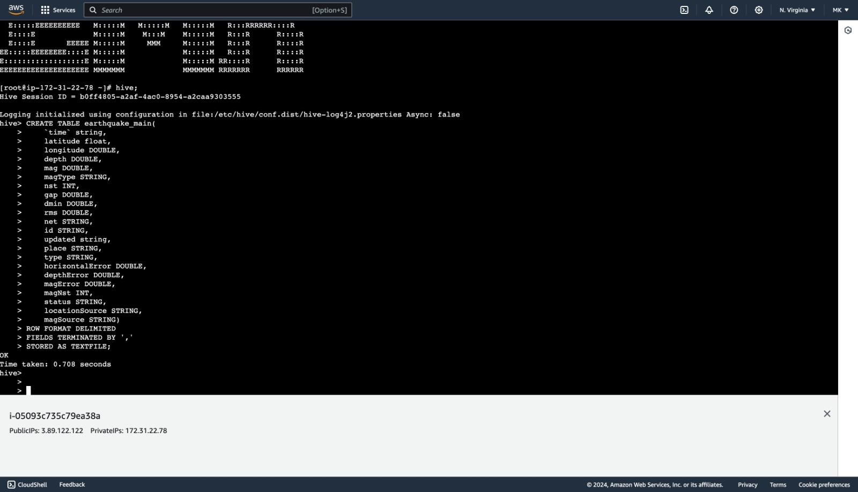
Integration
From the dataset we loaded in the bucket. We used hive to perform operations and queries on it to minimize the data discrepancies. This modified data is then stored back to the bucket. The stored new data is loaded into pyspark and undergone data preprocessing steps. Then we move on to machine learning and data visualizations which can be seen in the figures above/below.

Slide 17
Explanation of Integration
Hive was used to create and manage structured tables (earthquake_current and earthquake_main) that store earthquake-related data.
The data from the earthquake datasets (usgc_current.csv and usgc_main.csv) was loaded into these Hive tables using HiveQL (Hive Query Language) commands.
Hive provided a SQL-like interface to perform data processing and analysis tasks directly on the stored earthquake data.
Hive was integrated into the earthquake analysis project to manage, query, and analyze earthquake data efficiently within the Hadoop ecosystem, enabling seamless data processing and integration with other technologies used.

Slide 18
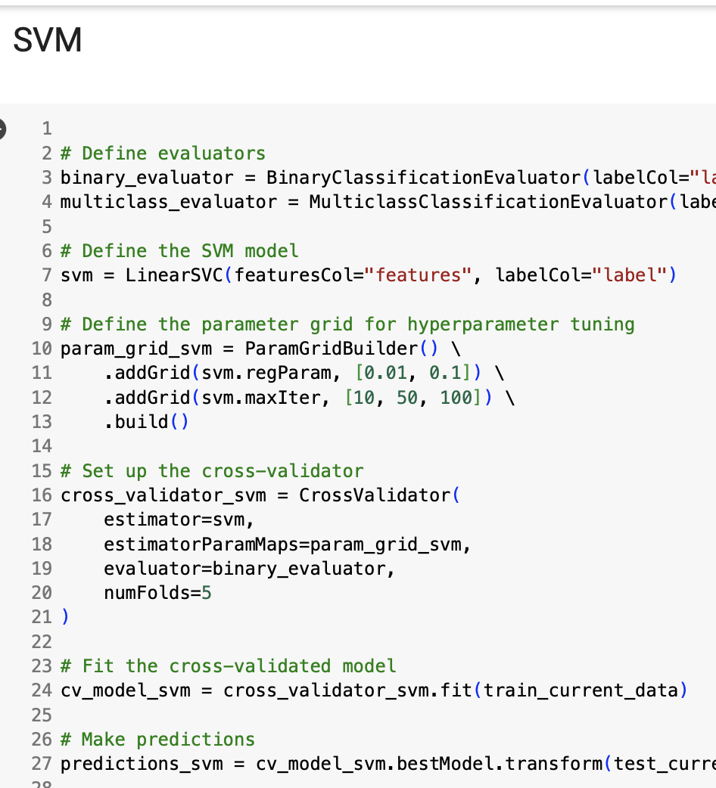
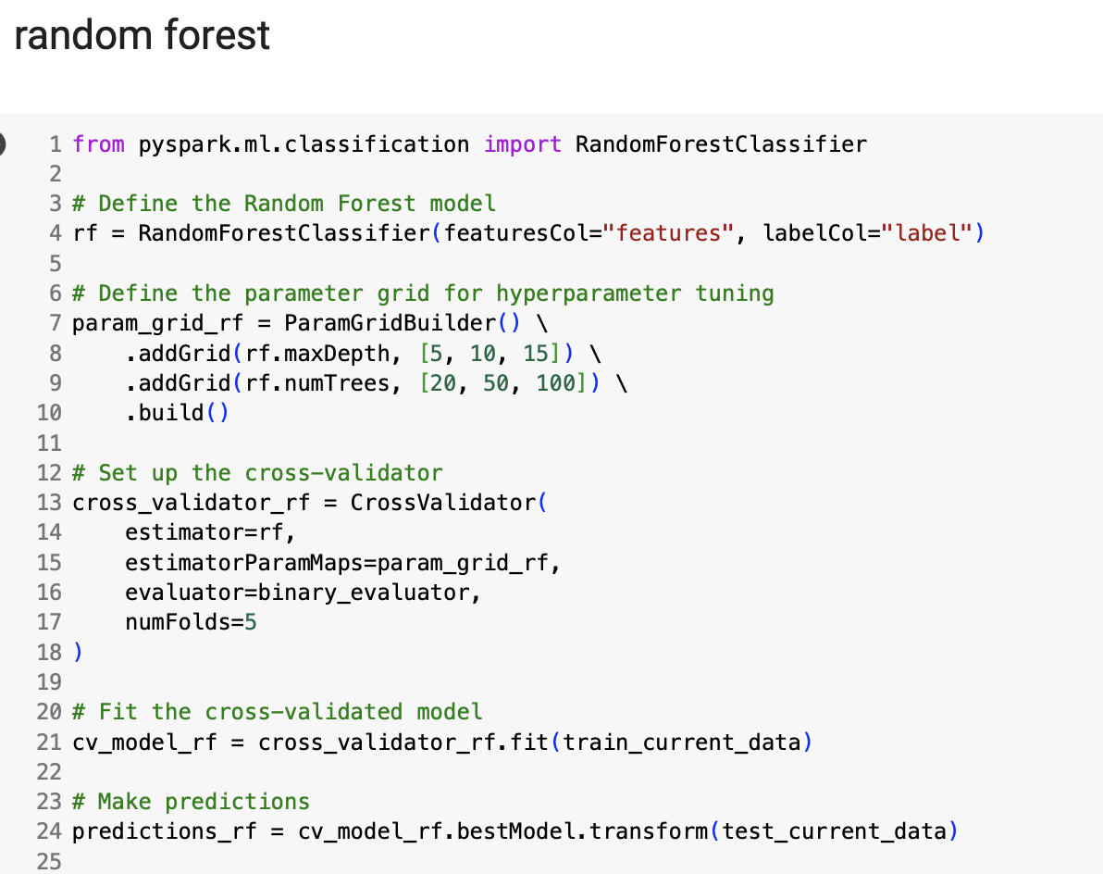
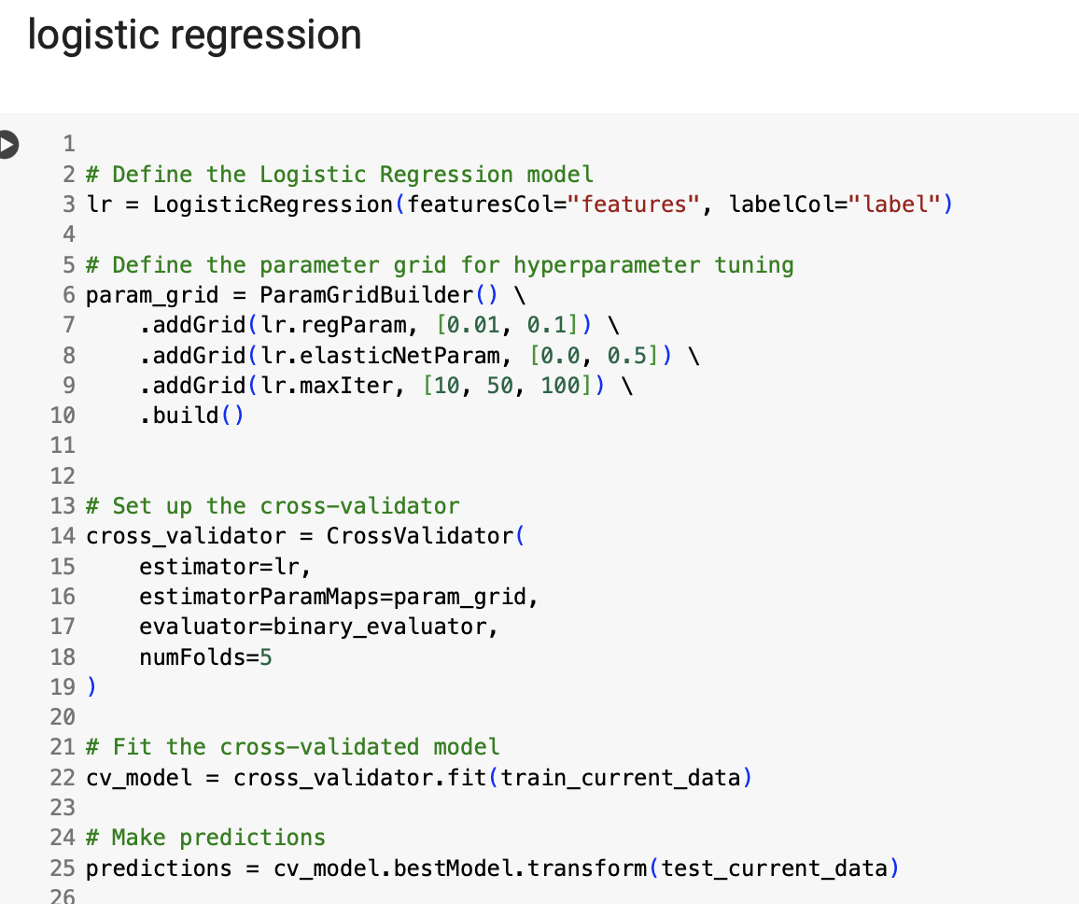
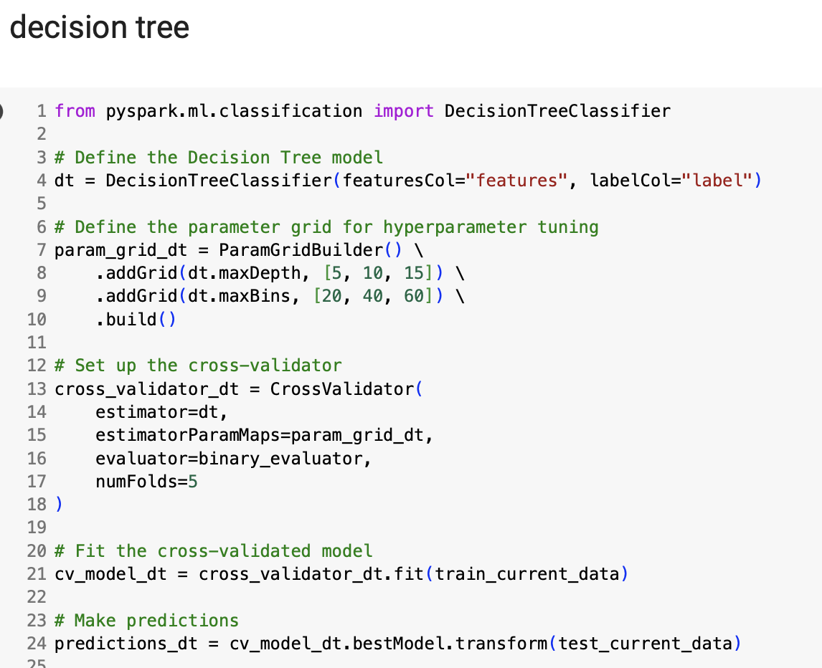
Models:
We used PySpark to build various machine learning models such as SVM, Random Forest, Logistic Regression and Decision Tree and predict their accuracies.
We applied hyperparameter tuning to each model to find the optimal settings. Additionally, We conducted cross-validation for every model.

Slide 19
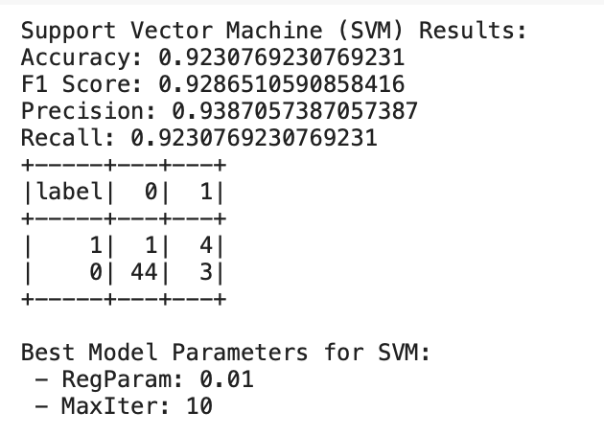
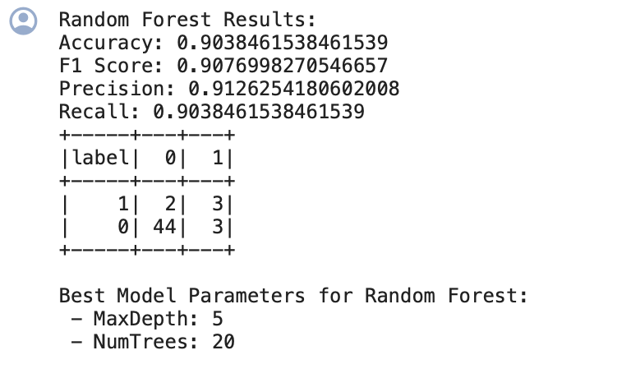
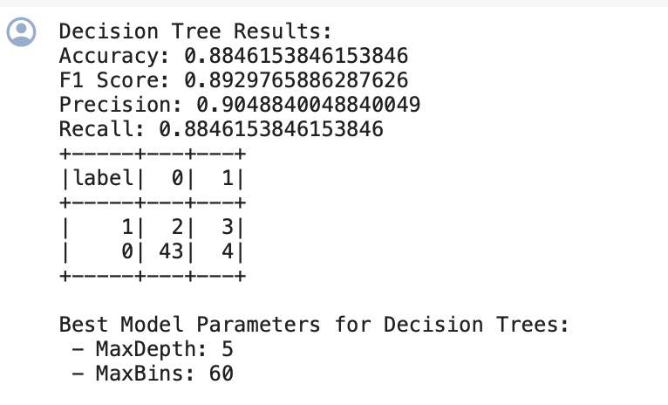
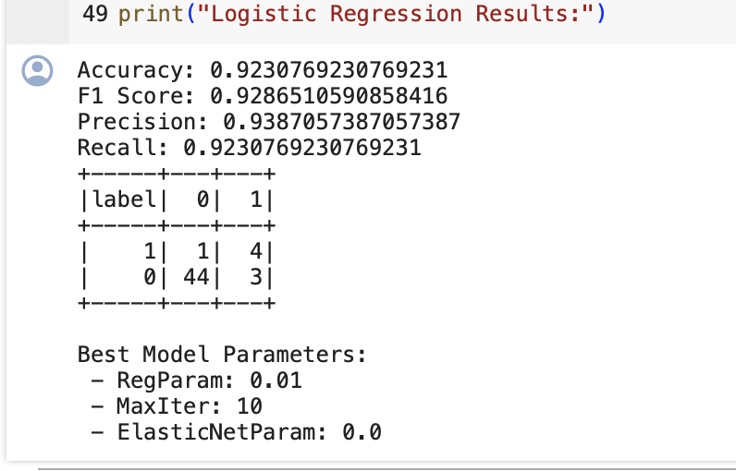
Results
After building the models, we evaluated them using test data, focusing on metrics such as F1 score, Precision, Recall, and Accuracy.
All models shows the high accuracy, indicating a good fit. Among all the models compared, the Support Vector Machine achieved the highest accuracy, which is the 92.30%

Slide 20
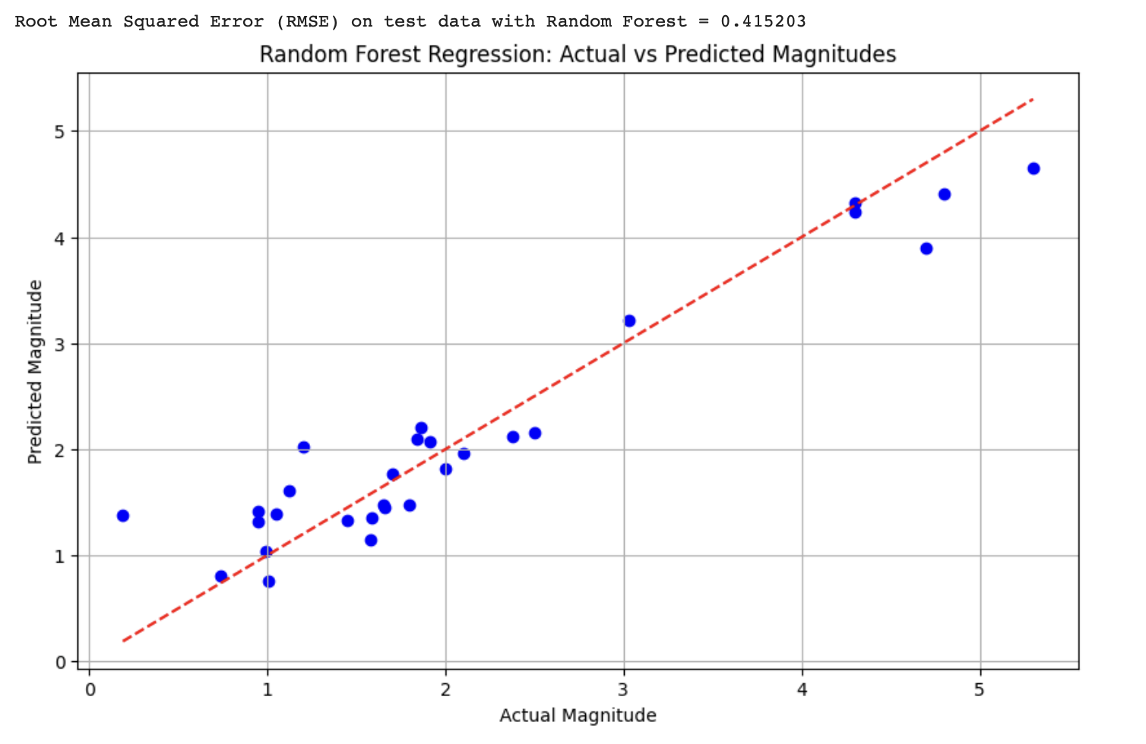
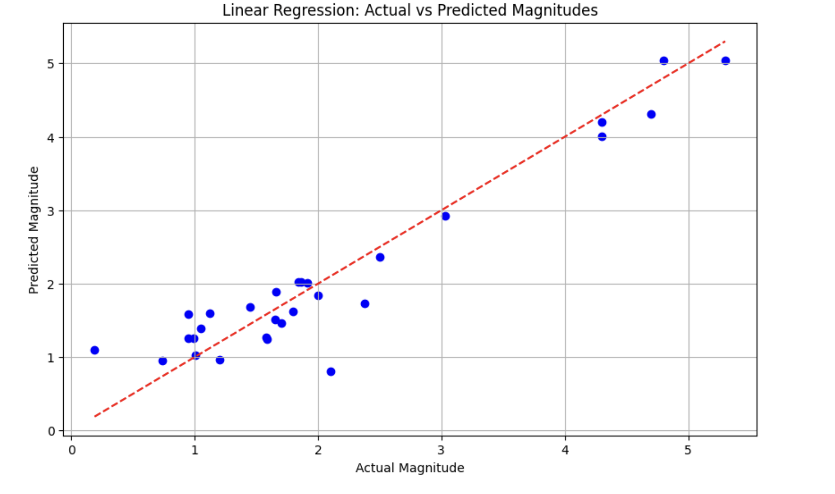
Prediction Plots:
Comparison of actual vs. predicted earthquake magnitudes using a Random Forest regression and Linear Regression models and the data points closely aligning along with the red line of perfect prediction.

Slide 21
Project Management
Criteria | Ashok | Tejas | Meghana
Data Pre-processing, Data Visualization, Model Building | 8% | 9% | 8%
Hive queries and PySpark coding | 8% | 8% | 9%
Integration to Big Data and Data Science/ Machine Learning | 8% | 8% | 9%
Documentation and PPT | 9% | 8% | 8%
Total | 33% | 33% | 34%
100%

Slide 22
Link
https://drive.google.com/file/d/1v4Y_1ZgGAe1Dd4sFxgD5eFDYhn5tmVvf/view?usp=share_link

